Slide 1
Decision trees
Lecture 2b

Slide 2
Decision trees
Idea
Split the domain of feature set into the set of hypercubes (rectangles, cubes) and define the target value to be constant within each hypercube
Regression trees:
Target is a continuous variable
Classification trees
Target is a class (qualitative) variable

Slide 3
Classification tree toy example
20
X1
<9
>=9
X2
X2
<16
>=16
<7
>=7
10
0
1
1
X1
<15
>=15
1
0
0
10
20

Slide 4
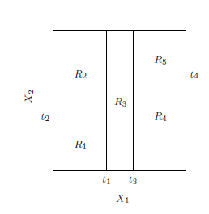
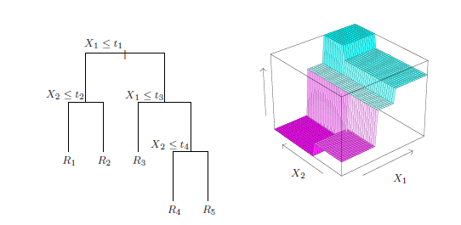
Regression tree toy example

Slide 5
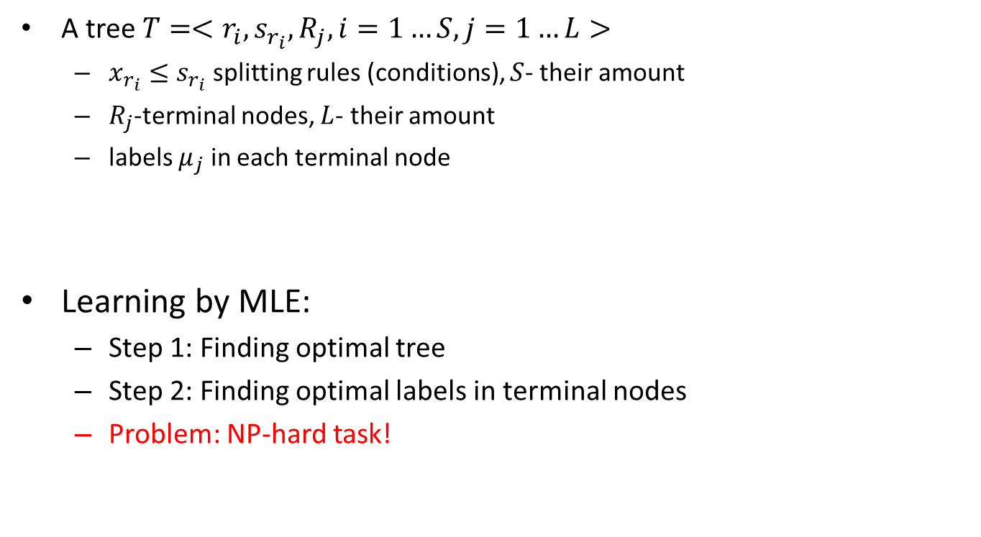
Decision trees
A tree $T=<r_{i},s_{r_{i}},R_{j}, i=1…S, j=1…L>$
$x_{r_{i}}≤s_{r_{i}}$ splitting rules (conditions), $S$- their amount
$R_{j}$-terminal nodes, $L$- their amount
labels $μ_{j}$ in each terminal node
Learning by MLE:
Step 1: Finding optimal tree
Step 2: Finding optimal labels in terminal nodes
Problem: NP-hard task!

Slide 6
Decision trees
Normal model leads to regression trees
Objective: MSE
Multinomial model leads to classification trees
Objective: cross-entropy (deviance)

Slide 7
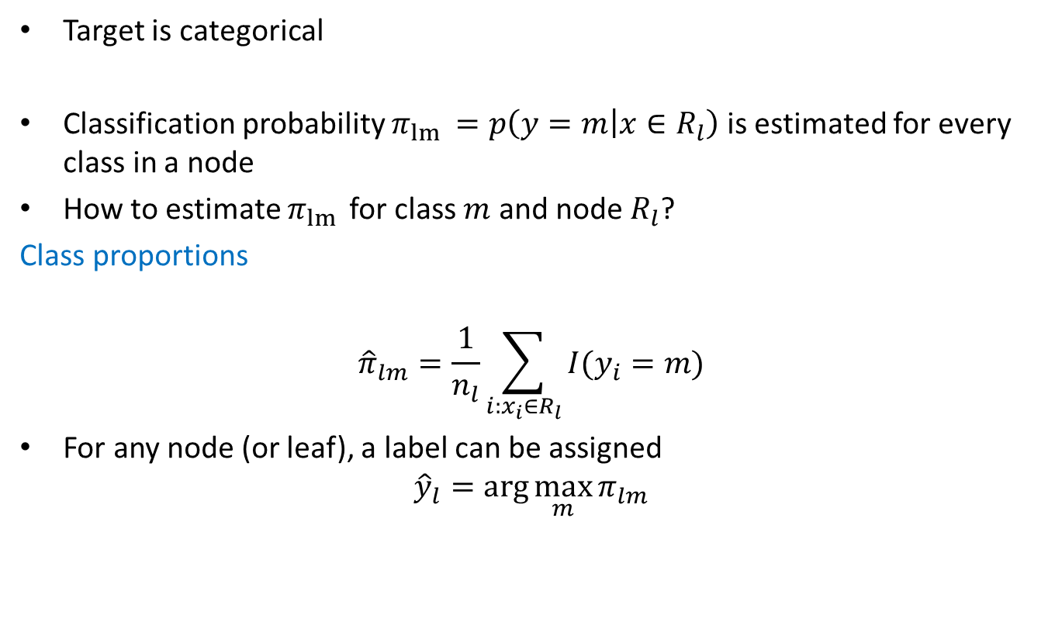
Classification trees
Target is categorical
Classification probability $π_{lm }=p\left(y=m | x∈R_{l}\right)$ is estimated for every class in a node
How to estimate $π_{lm }$for class $m$ and node $R_{l}$?
Class proportions
$${\hat{π}}_{lm}=\frac{1}{n_{l}}\sum_{i:x_{i}∈R_{l}}{I(y_{i}=m)}$$
For any node (or leaf), a label can be assigned
$${\hat{y}}_{l}=\arg{\max_{m}{π_{lm}}}$$

Slide 8
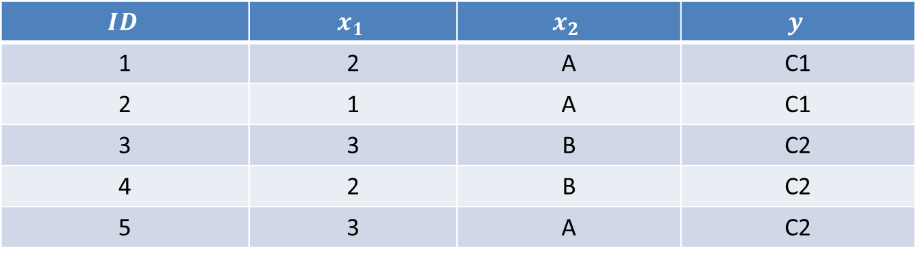
Example
$$ID$$ | $$x_{1}$$ | $$x_{2}$$ | $$y$$
1 | 2 | A | C1
2 | 1 | A | C1
3 | 3 | B | C2
4 | 2 | B | C2
5 | 3 | A | C2

Slide 9



Example
Splitting on $x_{2}$
$n_{1}=3$
$n_{2}=2$
${\hat{π}}_{11}=\frac{2}{3}$
${\hat{π}}_{12}=\frac{1}{3}$
${\hat{π}}_{21}=0$
${\hat{π}}_{22}=1$
${\hat{y}}_{1}=c1$
${\hat{y}}_{2}=c$2
$$x_{2}=A$$
$$x_{2}=B$$
R1
R2
1
2
5
3
4

Slide 10
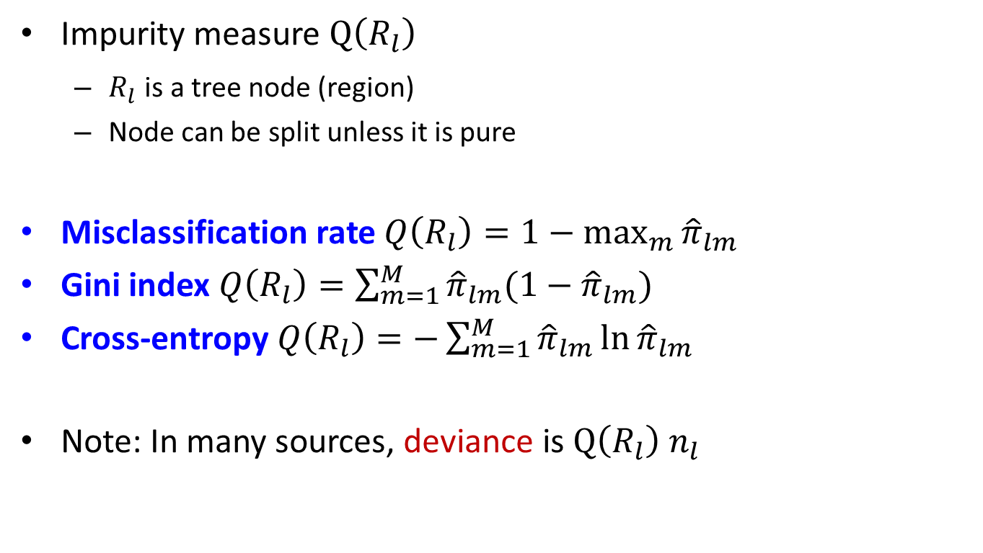
Classification trees
Impurity measure $Q\left(R_{l}\right)$
$R_{l}$ is a tree node (region)
Node can be split unless it is pure
Misclassification rate $Q\left(R_{l}\right)=1−\max_{m}{{\hat{π}}_{lm}}$
Gini index $Q\left(R_{l}\right)=\sum_{m=1}^{M}{{\hat{π}}_{lm}(1−{\hat{π}}_{lm}})$
Cross-entropy $Q\left(R_{l}\right)=−\sum_{m=1}^{M}{{\hat{π}}_{lm}\ln{{\hat{π}}_{lm}}}$
Note: In many sources, deviance is $Q\left(R_{l}\right) n_{l}$

Slide 11

Example
Misclassification rate
$Q\left(R1\right)=1/3$
Gini index
$Q\left(R1\right)=4/9$

Slide 12
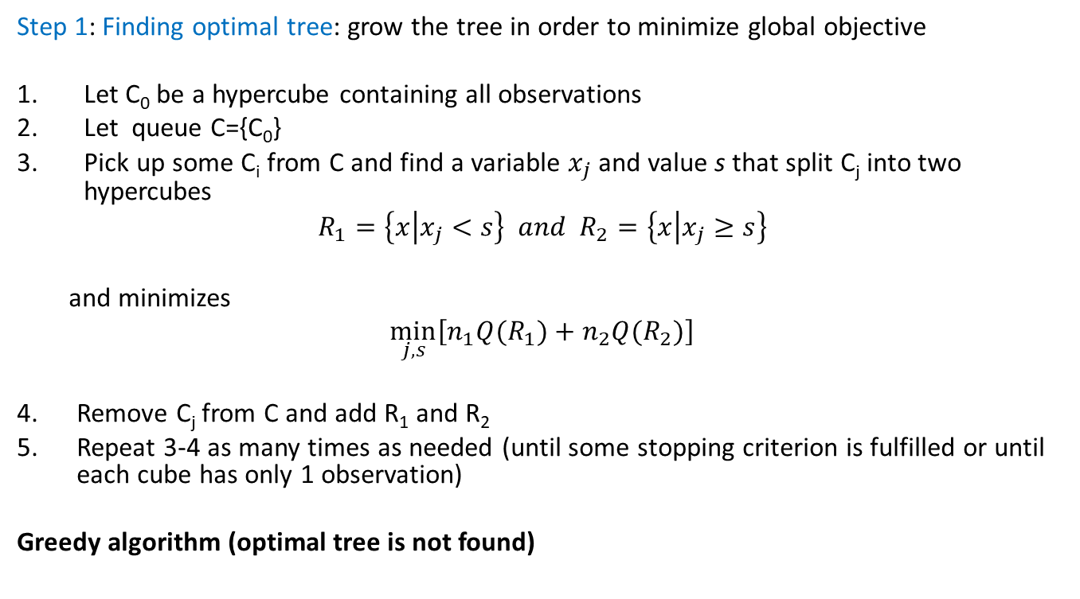
Learning classification trees: CART
Step 1: Finding optimal tree: grow the tree in order to minimize global objective
Let C₀ be a hypercube containing all observations
Let queue C={C₀}
Pick up some C_{i} from C and find a variable $x_{j}$ and value s that split C_{j} into two hypercubes
$$R_{1}=\left\{x | x_{j}<s\right\} and{ R}_{2}=\left\{x | x_{j}≥s\right\}$$
and minimizes
$$\min_{j,s}\left[n_{1}Q(R_{1})+n_{2}Q(R_{2})\right]$$
Remove C_{j} from C and add R₁ and R₂
Repeat 3-4 as many times as needed (until some stopping criterion is fulfilled or until each cube has only 1 observation)
Greedy algorithm (optimal tree is not found)

Slide 13
Example
$$ID$$ | $$x_{1}$$ | $$x_{2}$$ | $$y$$
1 | 2 | A | C1
2 | 1 | A | C1
3 | 3 | B | C2
4 | 2 | B | C2
5 | 3 | A | C2

Slide 14




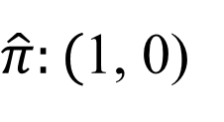


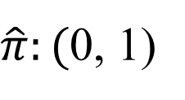
Example
Case 1
Case 2
$$x_{1}<2$$
$$x_{1}≥2$$
$$x_{1}<3$$
$$x_{1}≥3$$
R1
R2
R1
R2
1
2
4
3
5
2
1
3
4
5
$\hat{π}:($1, 0)
$\hat{π}:($1/4, 3/4)
$\hat{π}:($2/3, 1/3)
$\hat{π}:($0, 1)

Slide 15

Example
Assuming Gini index
Case 1
$Q\left(R_{1}\right)=0$
$Q\left(R_{2}\right)=3/8$
$n_{1}Q\left(R_{1}\right)+n_{2}Q\left(R_{2}\right)=1.5$
Case 2
$Q\left(R_{1}\right)=4/9$
$Q\left(R_{2}\right)=0$
$n_{1}Q\left(R_{1}\right)+n_{2}Q\left(R_{2}\right)=1.33$

Slide 16
CART: comments
When to stop tree growing?

Slide 17
CART: comments
The largest tree will interpolate the data → large trees = overfitting the data
Too small trees=underfitting (important structure may not be captured)
Optimal tree size?

Slide 18
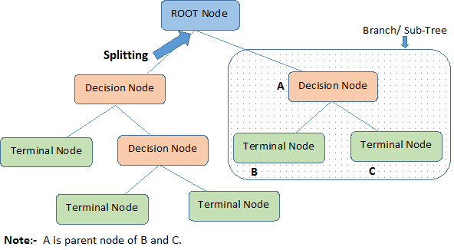
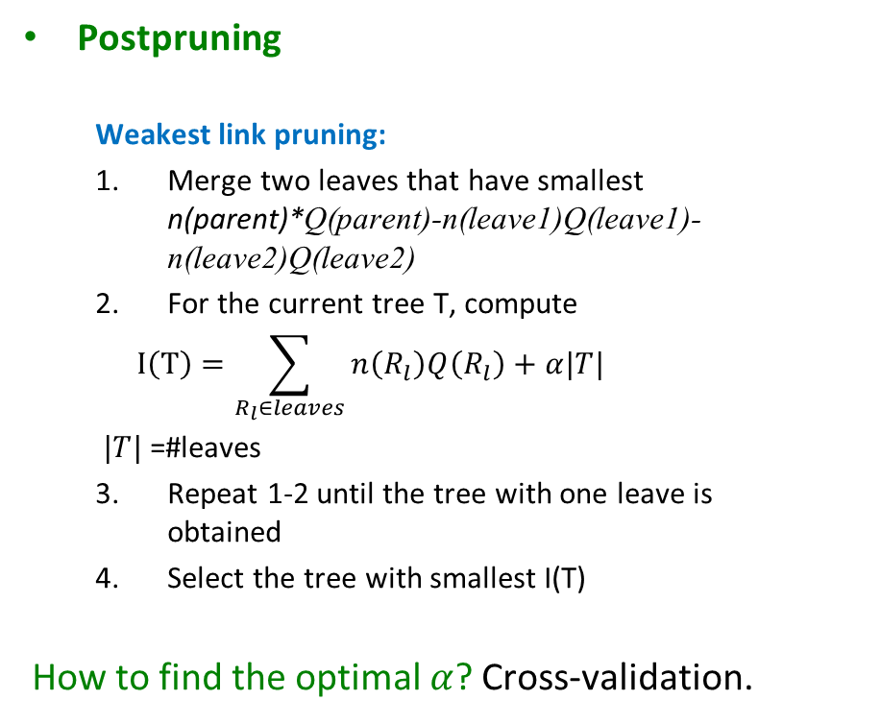
Optimal trees
Postpruning
Weakest link pruning:
Merge two leaves that have smallest n(parent)*Q(parent)-n(leave1)Q(leave1)-n(leave2)Q(leave2)
For the current tree T, compute
$$I\left(T\right)=\sum_{R_{l}∈leaves}{n\left(R_{l}\right)Q\left(R_{l}\right)+α|T|}$$
$|T|$ =#leaves
Repeat 1-2 until the tree with one leave is obtained
Select the tree with smallest I(T)
How to find the optimal $α$? Cross-validation.
Source: http://www.analyticsvidhya.com

Slide 19





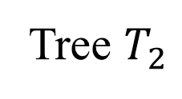

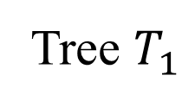
Example
Tree $T_{1}$
Tree $T_{2}$
$$x_{1}<3$$
$$x_{1}≥3$$
R1
R2
$$x_{1}<3$$
$$x_{1}≥3$$
1
2
4
3
5
R1
R2
$$x_{2}=A$$
$$x_{2}=B$$
1
2
4
3
5
R3
R4
1
2
4

Slide 20

Example
Parent: $R_{1}$, Children:${ R}_{3}, R_{4}$
Assume
Gini index
$\left|T\right|=\#leaves$
$α=1$
$I\left(T_{1}\right)=3$
$I\left(T_{2}\right)=3.33$

Slide 21
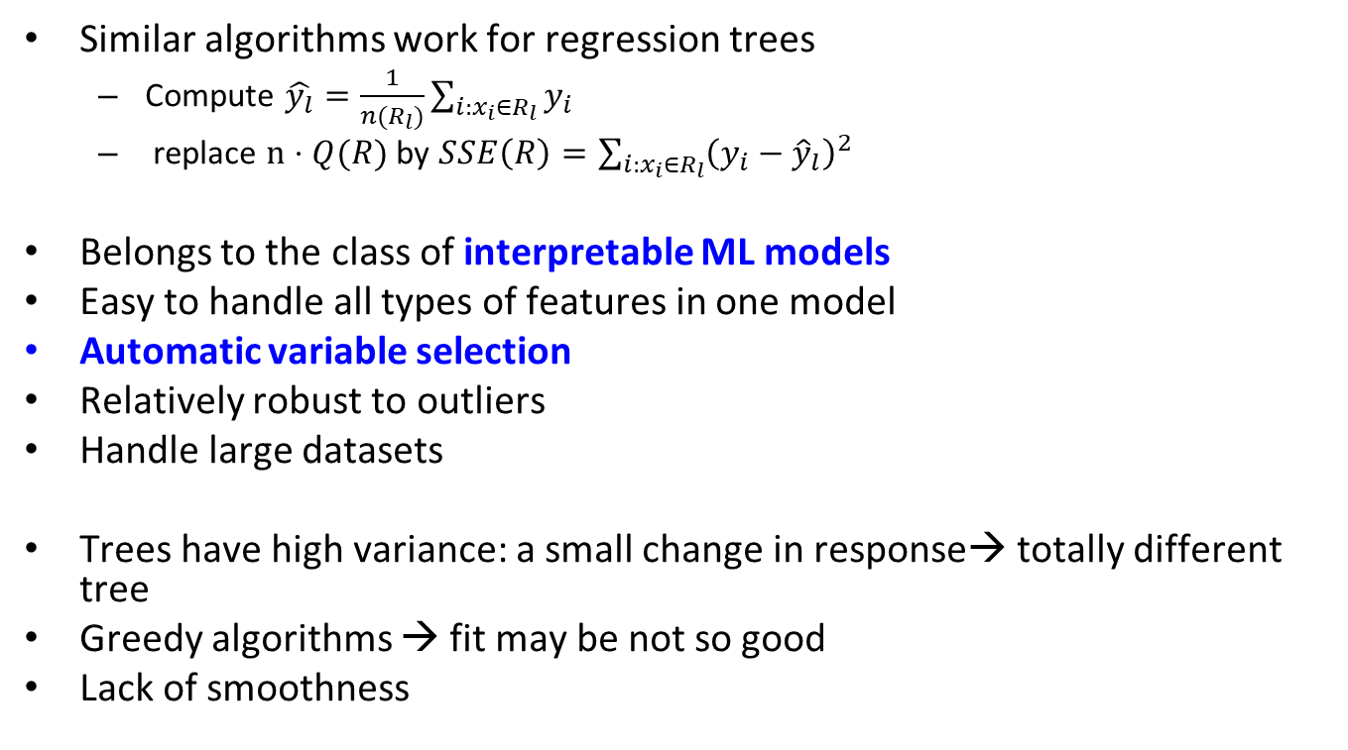
Decision trees: comments
Similar algorithms work for regression trees
Compute $\hat{y_{l}}=\frac{1}{n(R_{l})}\sum_{i:x_{i}∈R_{l}}{y_{i}}$
replace $n⋅Q(R)$ by $SSE\left(R\right)=\sum_{i:x_{i}∈R_{l}}{{\left(y_{i}−{\hat{y}}_{l}\right)}^{2}}$
Belongs to the class of interpretable ML models
Easy to handle all types of features in one model
Automatic variable selection
Relatively robust to outliers
Handle large datasets
Trees have high variance: a small change in response→ totally different tree
Greedy algorithms → fit may be not so good
Lack of smoothness

Slide 22
Decision trees: issues
Large trees may be needed to model an easy system:

Slide 23
Decision trees in R
tree package
Alternative: rpart
tree(formula, data, weights, control, split = c("deviance", "gini"), …)
print(), summary(), plot(), text()
Example: breast cancer as a function av biological measurements
library(tree)
n=dim(biopsy)[1]
fit=tree(class~., data=biopsy)
plot(fit)
text(fit, pretty=0)
fit
summary(fit)

Slide 24
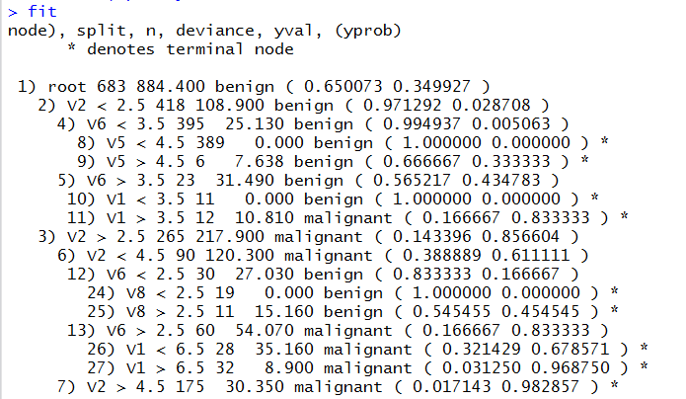
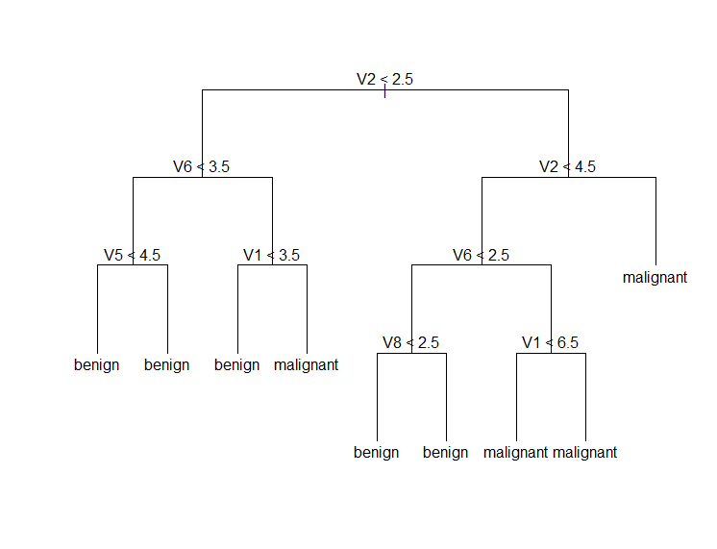
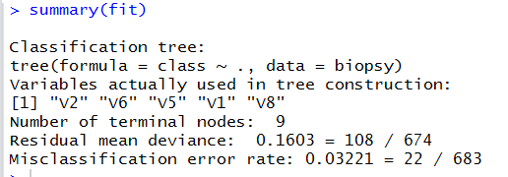
Decision trees in R
Adjust the splitting in the tree with control parameter (leaf size for ex)

Slide 25
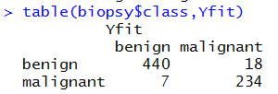
Decision trees in R
Misclassification results
Yfit=predict(fit, newdata=biopsy, type="class")
table(biopsy$class,Yfit)

Slide 26
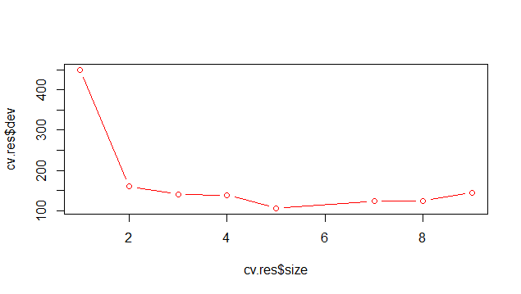
Decision trees in R
Selecting optimal tree by penalizing
Cv.tree()
set.seed(12345)
ind=sample(1:n, floor(0.5*n))
train=biopsy[ind,]
valid=biopsy[-ind,]
fit=tree(class~., data=train)
set.seed(12345)
cv.res=cv.tree(fit)
plot(cv.res$size, cv.res$dev, type="b", col="red")
What is optimal number of leaves?

Slide 27
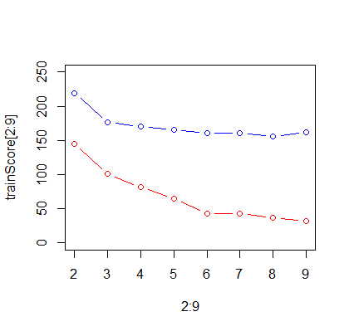
Decision trees in R
Selecting optimal tree by train/validation
fit=tree(class~., data=train)
trainScore=rep(0,9)
testScore=rep(0,9)
for(i in 2:9) {
prunedTree=prune.tree(fit,best=i)
pred=predict(prunedTree, newdata=valid, type="tree")
trainScore[i]=deviance(prunedTree)
testScore[i]=deviance(pred)
}
plot(2:9, trainScore[2:9], type="b", col="red", ylim=c(0,250))
points(2:9, testScore[2:9], type="b", col="blue")
What is optimal number of leaves?

Slide 28
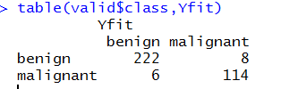
Decision trees in R
Final tree: 5 leaves
finalTree=prune.tree(fit, best=5)
Yfit=predict(finalTree, newdata=valid, type="class")
table(valid$class,Yfit)

